Slide 1

A new evolutionary model
for universities
Co - creation for innovation
with society and for society
Shojiro Nishio, PhD
President, Osaka University

Slide 2

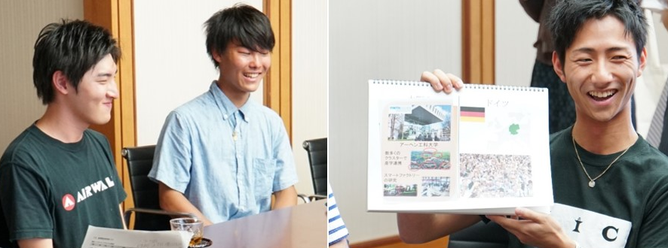
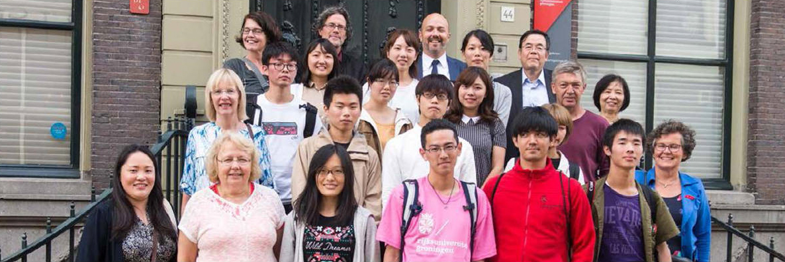
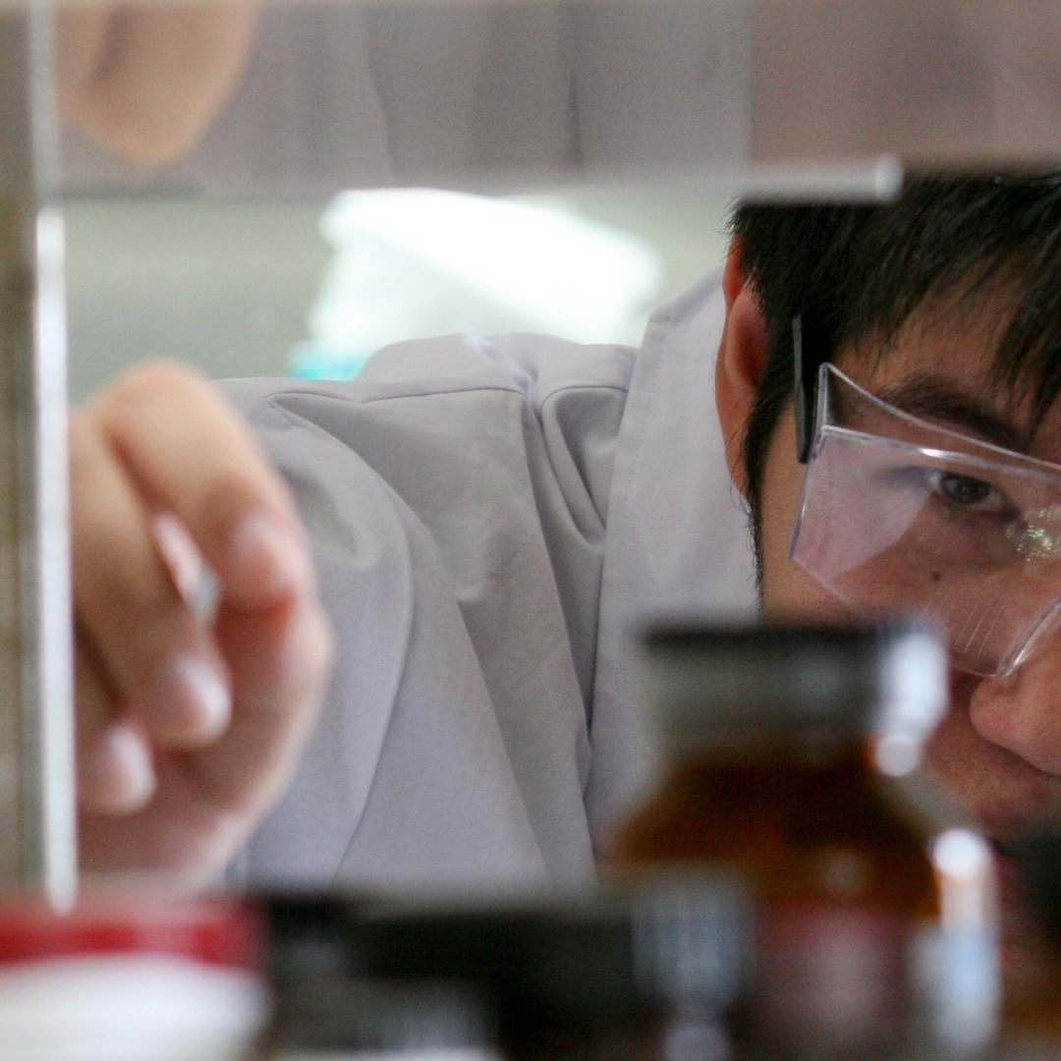

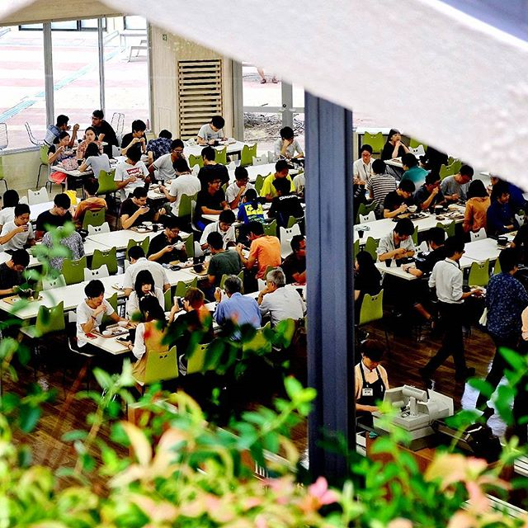
Osaka University: Facts and Figures
(as of May 1, 2017)
11
16
17
Schools
Graduate Schools
Joint-Use Facilities, etc.
2
4
6
University
Hospitals
University Libraries
Research Institutes
One of Japan’s Leading National Universities
■Undergraduate Students | 15,358 | (Female ratio: 33.6％）
■Graduate Students | 7,930 | (Female ratio: 28.3％）
■International Students (Inbound) | 2,273
■Students Studying Abroad (Outbound) | 1,629 | (Apr. 1, 2016 – Mar. 31, 2017)

Slide 3
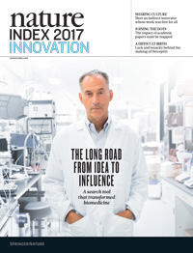
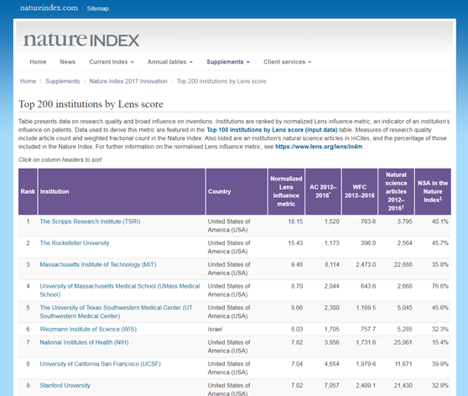
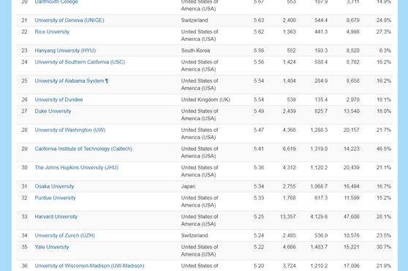
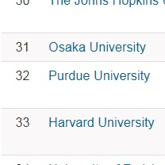
World-Leading Innovative University
https://www.natureindex.com/supplements/nature-index-2017-innovation /tables/top200-institutions-lens
World Rankings for Innovation
Nature Index Innovation
2017
31 (1 )
Reuters Top 100:
The World’s Most Innovative University
2015
18 (1 )
* Numbers in parentheses indicate ranking among universities in Japan.

Slide 4
Investment Trends of Fundamental Academic Research
Basic expenses of the university from the government are trending downwards, and although research grants are increasing, it is still becoming difficult to meet overall monetary goals; financially, all costs are being reduced.
(in millions
of yen)
（100）
17,508
（96.0）
16,807
（93.9）
16,441
0
(FY)
Source: MEXT
*Based on the financial report of scientific research in FY2016
*Numbers in parenthesis are from the total expenses on a ratio of 100 in FY2004

Slide 5
Recent Progress of Osaka University
Index | 2011 | 2016
Faculty members | 2,609 | 2,518
Publications | 4,519 | 4,512 | InCites
International joint publications | 27.4% | 33.2% | InCites
KAKENHI projects | 2,424 | 2,585
Research income from industries | JPY 2.87billion (CNY 169million） | JPY 4.41billion （CNY 260million）
Income by patents | JPY 76million | JPY 119million
KAKENHI: Grants-in-Aid for Scientific Research from the government
1JPY=0.059CNY as of September 14, 2017
1JPY=0.009US$ as of September 14, 2017

Slide 6




Industry-University Collaboration
Stage 2
First
in
Japan
66 Joint Research Labs*
at Osaka University
*Excluding 46 Endowed Chairs.
As of September 1, 2017
Industry on Campus!!
Stage 1
● Technology consultations
● Individual joint research
*
2 types of Joint Research Labs:
1. Joint Research Chair: Company labs on campus
2. Research Alliance Laboratories: Larger-scale corporate labs on campus

Slide 7

From Collaboration to Co-Creation
Stakeholders
in Society
Future
Industry-University /
Society-University
Co-Creation
Innovation through Co-Creation
Citizens
NPOs
Inter-organizational partnership
From the stage of defining the issues and basic research
Issues
Co-Creation
Interdisciplinary
knowledge
NGOs
Local Governments
International Organizations
“What to do”
“Why we do”
Traditional Model of
Industry-University
Collaboration
Japanese
Government
Issues
Research Institutions
Interdisciplinary
knowledge
Collaboration
Individual researchers and companies
Issues predetermined by companies
Industries
“How to do”

Slide 8
Co-creation: Approach 1 (Research)
Transforming the university with "Co-creation"
Implementing a virtuous cycle of knowledge, talent, and funds
1
Comprehensive industry-university collaboration from the fundamental research stage
Industry-University Collaboration
Industry-
University
Co-Creation
2
Nurture innovative leaders through Co-creation
Stage 3
3
Nurture/employ young researchers through
Co-creation
4
Promote gender equality facilitated by our industry-university circular development program
Stage 2
Development of the university's “seed base”
collaborative research systems
First
in Japan
66 joint research labs
As of September 1, 2017
Stage 1
Technology consultations
Individual joint research

Slide 9









Osaka University –style Comprehensive Co-creation with Industry
Donations
Private
Research Funds
Comprehensive
Co-creation
Disclosure of Research Results
New Joint Research Agreement
Intellectual Property Rights

Slide 10
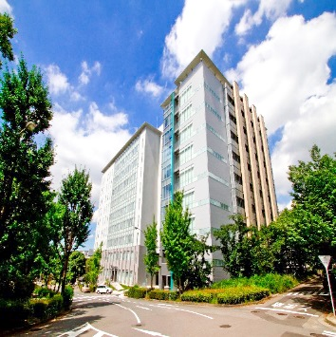
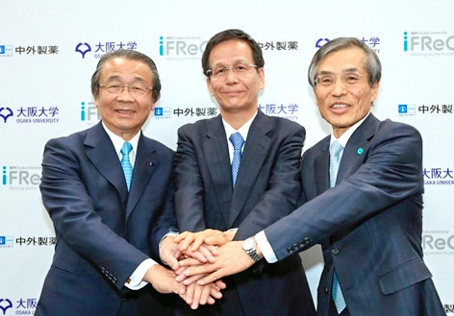
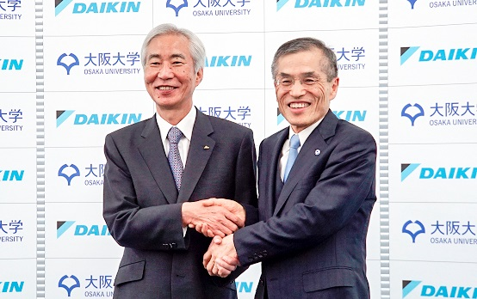
Inter-organizational Partnerships beginning
from the Fundamental Research Stage for Co-creation
February 2017
For cutting-edge immunology research activities with Otsuka Pharmaceutical Co., Ltd.
Support for administration costs for 10 years
Pharmaceuticals
May 2016
For cutting-edge immunology research activities with Chugai Pharmaceutical Co., Ltd.
Support for administration costs for 10 years (1 billion yen per year totaling 10 billion)
Information
Technology
June 2017
In the field of Information Technology with Daikin Industries, Ltd.
Support to implement co-creation for 10 years (500 million yen per year, totaling 5.6 billion [incl. research equipment costs])

Slide 11
Co-creation: Approach 2 (Education)
Transforming the university with "Co-creation"
Implementing a virtuous cycle of knowledge, talent, and funds
1
Comprehensive industry-university collaboration from the fundamental research stage
Industry-University Collaboration
Industry-
University
Co-Creation
2
Nurture innovative leaders through Co-creation
Stage 3
3
Nurture/employ young researchers through
Co-creation
4
Promote gender equality facilitated by our industry-university circular development program
Stage 2
Development of the university's “seed base”
collaborative research systems
First
in Japan
66 joint research labs
As of September 1, 2017
Stage 1
Technology consultations
Individual joint research

Slide 12

Nurture Innovative Leaders through Co-creation
Osaka University and Panasonic to Begin
Joint Collaborative Course in Artificial Intelligence
— Joint Collaborative Course in the Field of Artificial Intelligence is the First of Its Kind in Japan* —
*According to a survey by Panasonic Corporation (June 21, 2016)
Nurture individuals in AI technology and its research and business applications
with classroom lectures and practical learning through projects
Joint Collaborative Course in
Artificial Intelligence
Interdisciplinary
Talent
2. AI Business Model Program
Five Business
Initiatives
(Program for Leading Graduate Schools)
Innovation on Existing Business and
Creation of New Business for
a Data-Driven Society
(Consumer Electronics,
Housing, Automotive,
B2B, Devices)
Intelligence Science
and Technology
1. AI Technology Integration Program
Data on Business
Activities
(Graduate School of Information Science and Technology)
Jointly Develop a Systematic Curriculum
for AI Education
(Information on R&D, Production, and Sales)
Implementation of an organizational structure and course programs that make use of the strengths of Panasonic and Osaka University

Slide 13
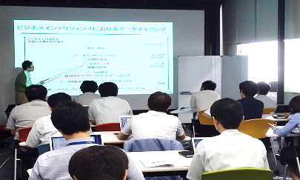
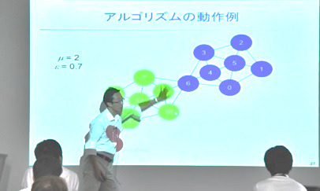
Nurture Innovative Leaders through Co-creation
Trial run implemented at the Panasonic AI Hub at Osaka for courses in the Basics of Data Mining and Machine Learning in AY2016.
Since AY2017, other subjects joined the curriculum, and Joint Courses were opened to students and employees of other companies under the joint supervision of Osaka University and Panasonic.
Osaka
University
Promote new student interdisciplinary research based on the induction of cross-referenced data from different academic fields with artificial intelligence at the core, and at the same time aim to train personnel in the applied learning utilized at the Institute for Datability Science.
Tender technological innovative solutions to other companies while demonstrating projects that develop research, products, manufacturing, marketing, and customer support.
Panasonic
Actual Lecture

Slide 14
Co-creation: Approach 3 (Nurturing Researchers)
Transforming the university with "Co-creation"
Implementing a virtuous cycle of knowledge, talent, and funds
1
Comprehensive industry-university collaboration from the fundamental research stage
Industry-University Collaboration
Industry-
University
Co-Creation
2
Nurture innovative leaders through Co-creation
Stage 3
3
Nurture/employ young researchers through
Co-creation
4
Promote gender equality facilitated by our industry-university circular development program
Stage 2
Development of the university's “seed base”
collaborative research systems
First
in Japan
66 joint research labs
As of September 1, 2017
Stage 1
Technology consultations
Individual joint research

Slide 15





Nurture/Employ Young Researchers through Co-creation
Critical
Issues!
Gradual decrease in Management Expenses Grant
Decrease in
tenure posts for young faculty members
Decrease in amount of time to concentrate on research
Decrease in research ability
In order to solve these problems
Institute for Advanced
Co-Creation Studies
Giving Dreams to
Outstanding Young
Researchers!
Financial support through donations, etc.
Hire Specially Designated
Professors
Corporations,
Various Groups
Cultivate internationally outstanding researchers
Promote research at the world’s highest level
High-level research management ability and high sense of morals
The first phase has already begun with the support of
the Research Foundation for Microbial Diseases of Osaka University,
and Daikin Industries, Ltd.

Slide 16
Co-creation: Approach 4 (Gender Diversity)
Transforming the university with "Co-creation"
Implementing a virtuous cycle of knowledge, talent, and funds
1
Comprehensive industry-university collaboration from the fundamental research stage
Industry-University Collaboration
Industry-
University
Co-Creation
2
Nurture innovative leaders through Co-creation
Stage 3
3
Nurture/employ young researchers through
Co-creation
4
Promote gender equality facilitated by our industry-university circular development program
Stage 2
Development of the university's “seed base”
collaborative research systems
First
in Japan
66 joint research labs
As of September 1, 2017
Stage 1
Technology consultations
Individual joint research

Slide 17











Promoting Continuing Education and
Development of Women Researchers
Programs for developmental and
diverse career paths for women in research
Circular Development
Program
Research
Institutes
Realizing a diverse career path with multiple opportunities for career improvement.
●Joint Research
University
Cross-
Appointment
System
Industry
●Relearn
●Internship
Plans are in place to increase collaboration between research affiliates and corporations.
●Women researchers employed by the Cross-appointment system:
16 researchers (up to May 2017)

Slide 18
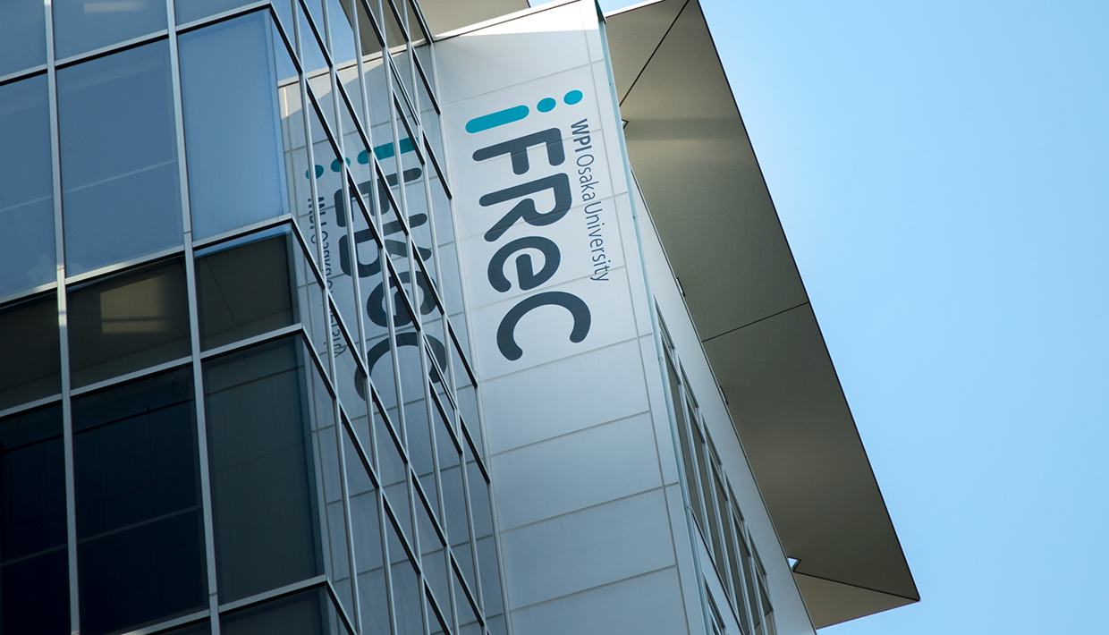

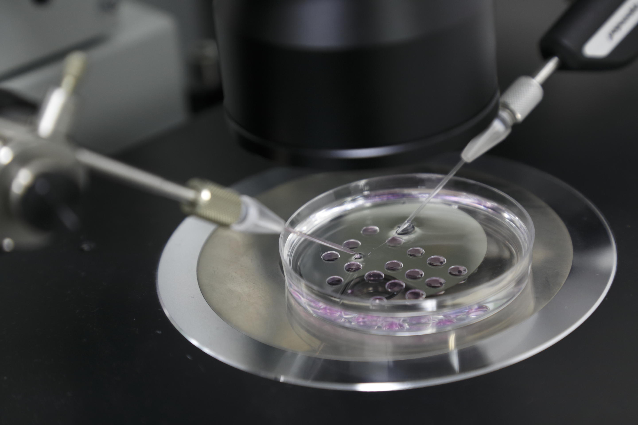




Leadership and Impact in Research
Three new research institutes
Innovation through co-creation
for social transformation
International Advanced Research Institute
Immunology Frontier Research Center
In development:
Biomedical Science Fusion Frontier Research
Symbiotic Intelligence System Research
Science of Light and Matter
Open and Transdisciplinary Research Initiatives
Create new research fields
Three-Dimensional Life System and Imaging
Environment and Energy ●Design Study of Living Space
Institute for Datability Science
Incubate new interdisciplinary research through data-driven approaches

Slide 19


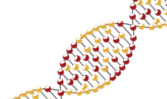
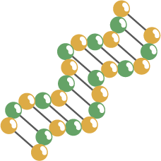

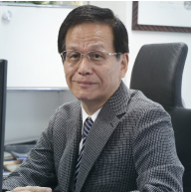
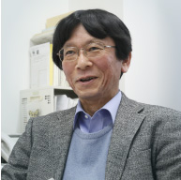
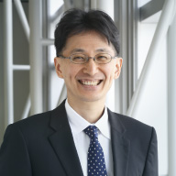
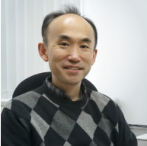
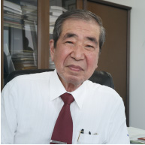
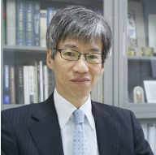
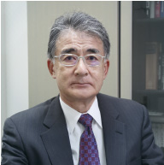
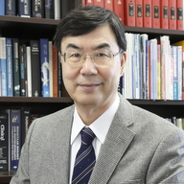
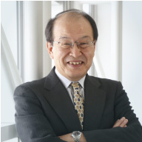
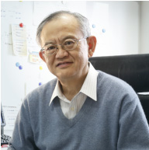
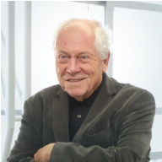
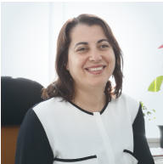
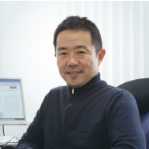
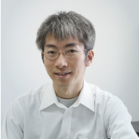
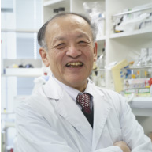
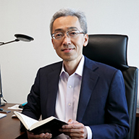
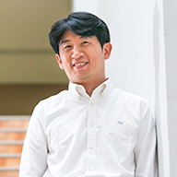
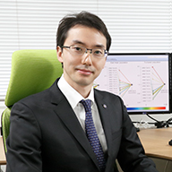
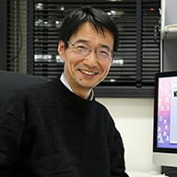
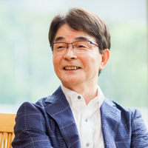
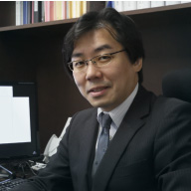


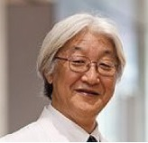
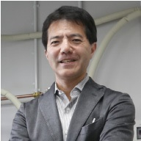
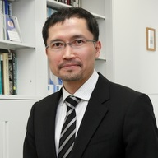
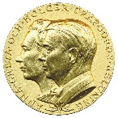


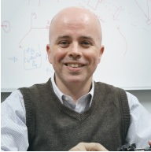
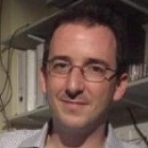
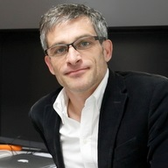
World-leading Immunology
Immunology Frontier Research Center
S. Akira
T. Kinoshita
A. Kumanogoh
H. Arase
T. Kishimoto
K. Takeda
H. Kikutani
S. Sakaguchi
T. Saito
T. Kurosaki
F. Melchers
C. Coban
International awards received by IFReC researchers：
K. J. Ishii
M. Yamamoto
S. Nagata
Gairdner International Award
Robert Koch Prize
T. Yamashita
S. Yamasaki
Y. Okada
T. Nagasawa
T. Yanagida
M. Ishii
Crafoord Prize
King Faisal
International Prize
Japan Prize
J. Hatazawa
K. Kikuchi
K. Suzuki
N. I. Smith
B. Seymour
D. Standley

Slide 20






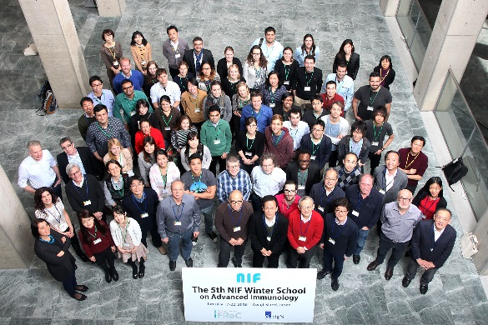

IFReC: International Hub for Immnology
The University
of Edinburgh
Karolinska Institutet
Imperial College
London
Free University of Berlin
Humboldt University of Berlin
Charite Medical University of Berlin
University of
California
Harvard
University
Monash University
Source: Web of Science 2014-2017 (August 21, 2017)

Slide 21

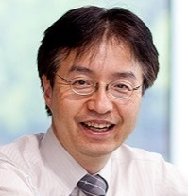
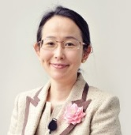
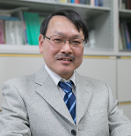
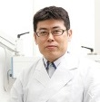



































World-leading Robotics
Integration of cognitive science, neuroscience,
and human-oriented Robotics
M. Asada
H. Ishiguro

Slide 22








SISReC: International Hub for Robotics
Bielefeld University
California Institute of Technology
Osaka
University
Istitute Italiano
di Tecnologia
University of Washington

Slide 23



International Networks: Strengthening Strategic Internationalization
Internationalization
at home and
in the region
Education and training
with global partners
Impact of research
on a global scale
Our Approaches:
Improve environment on campus and for living (OU Global Campus and Global Village)
Collaborate through overseas campuses (ASEAN Campus)
Collaborate at institutional level (Global Knowledge Partners)

Slide 24

OU Global Campus
Osaka University Global Campus, scheduled to open in 2021

Slide 25





ASEAN Campus
Vietnam Campus
in Vietnam Academy of
Science and Technology
Brunei Campus
in University
Brunei Darussalam
Fields:
bioengineering,
infectious diseases,
environmental
engineering,
halal science
and ICT
Thailand Campus
in Mahidol University
Indonesia Campus
in Bandung Institute
of Technology

Slide 26


Campus Asia (CA) Project
Global health leaders to solve
global health problem
Expansion of global research and
professional networks
Osaka
Shanghai Jiao Tong
Peking
Tsinghua
Tianjin U of Traditional Chinese Medicine
Internship
Yonsei
(Curriculum, Credit Transfer, Evaluation and Certification)
Long
PhD
Master
Under Grad
Period | One month |  | 3 to 6 months |  | 1 to 2 years
OUT | 20 |  | 20 |  | 20
IN | 20 |  | 20 |  | 20
 | Lecture, Practice, Seminar, Field and laboratory
 |  | Research, Theses
 |  |  |  |  | Double degree
Student
Short
Middle

Slide 27










Strategic Partnerships
The University of Edinburgh
University of Groningen
Karolinska Institutet
Shanghai Jiao
Tong University
University of
Washington
University of Toronto
Goethe University
Frankfurt
EPFL
University of California,
Berkeley
University College London
Mahidol University
Global
Knowledge
Partners
Global Knowledge
Partners
Monash
University
Cross-domain joint research
International industry-university collaboration
Cross-appointments
Admit/dispatch young researchers
Joint programs
Operation of mutual liaison offices
Inter-University
Partner Institutions
Collaboration across
multiple divisions/fields
Inter-Faculty
Partner Institutions
Collaboration among individual
researchers or specific fields

Slide 28














Next Evolution for Universities
Work
with society
Work
for society
Innovation through co-creation
for the betterment of society

Slide 29













Slide 30

Thank you

Slide 31




